Slide 1
RETAIL CUSTOMER INTELLIGENCE · END-TO-END DATA SCIENCE
Customer & Demand
Intelligence
Raw transactions → cleaning → star-schema warehouse → 4 ML analyses → £-value model. Business leads; technology serves.
Senior Data Scientist portfolio · public UK Online Retail II as a proxy for a major retailer

Slide 2
THE FOUNDATION
From 1.07M messy rows to a trustworthy warehouse
94%
5 tables
£19.64M
12
of 1.07M rows kept (audited)
star schema (fact + 4 dims)
revenue reconciled, 0 unmapped
LLM-built product categories
Visible, reusable cleaning (duplicates, cancellations, non-positive, service codes); a modelling
cleanse that keeps guests labelled Member/Non-Member; a feature foundation with the right
source-of-truth split (customer models on Members; demand & basket guest-inclusive); and an
LLM that created the product category dimension the raw data lacked.

Slide 3
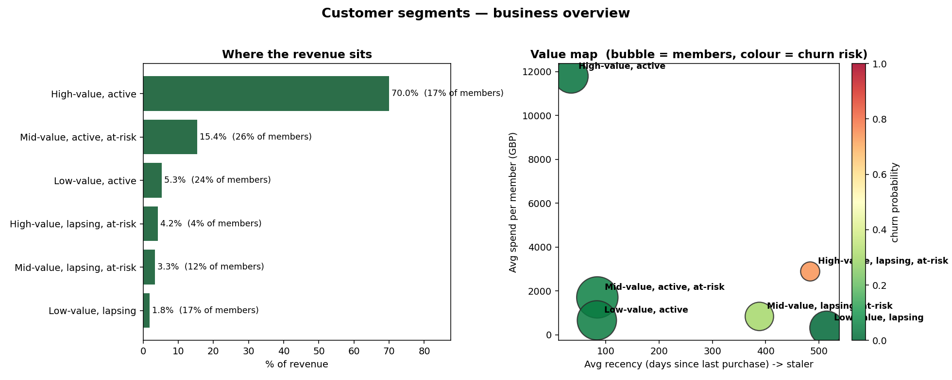
ANALYSIS 1 · SEGMENTATION
Six behavioural segments (RFMTC + K-Means)
Features: Recency, Frequency, Monetary, Tenure, and a BG/NBD churn term (RFMTC).
k=6 chosen on elbow + silhouette + business capacity.
17% of members drive 70% of revenue.
Prioritised: Protect · Rescue · Grow.
Revenue concentration (left) and the value map (right) — the small red bubble is the rescue target.

Slide 4
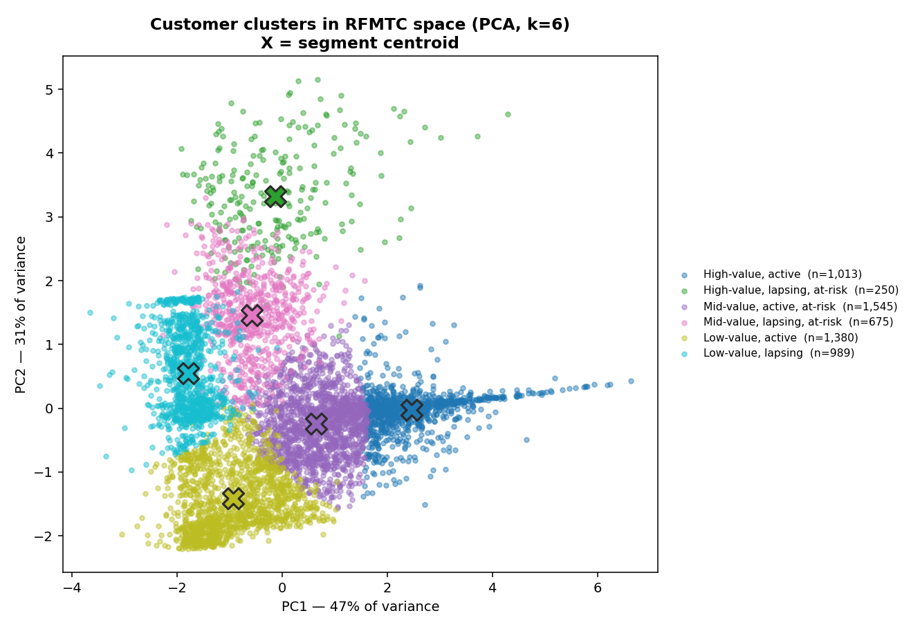
ANALYSIS 1 · CLUSTERS
Clusters in RFMTC space (PCA, 78% variance)
PCA projection of the standardised RFMTC features, coloured by segment.
Centroids marked; segments separate along a value-and-activity gradient.
Honest: silhouette ≈ 0.36 — real groups, but a continuum, not islands.

Slide 5
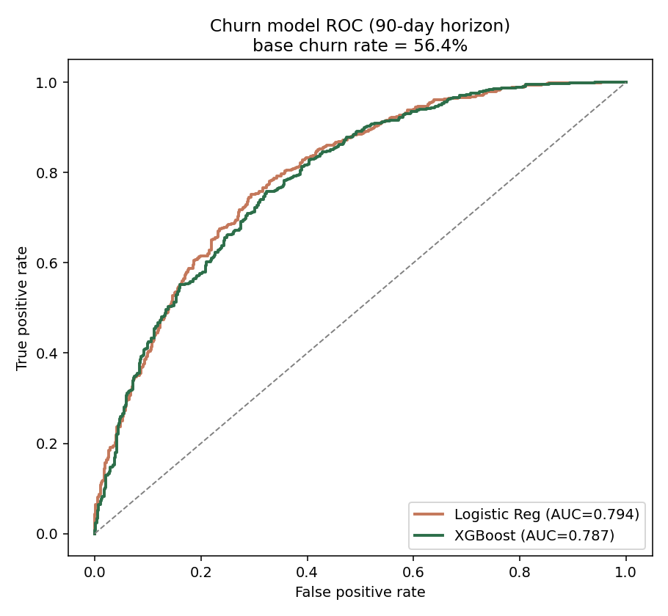
ANALYSIS 2 · CHURN
Leakage-safe churn model — AUC ≈ 0.79
Strict time split: features ≤ cutoff, label = no purchase in next 90 days.
Logistic ≈ XGBoost (0.79) — signal is mostly linear; we report that honestly.
Top drivers: recency & cadence — the 'overdue vs normal rhythm' signal.
Scores prioritise the 250-name rescue list.
ROC: both models ~0.79 vs the 0.5 chance line.

Slide 6
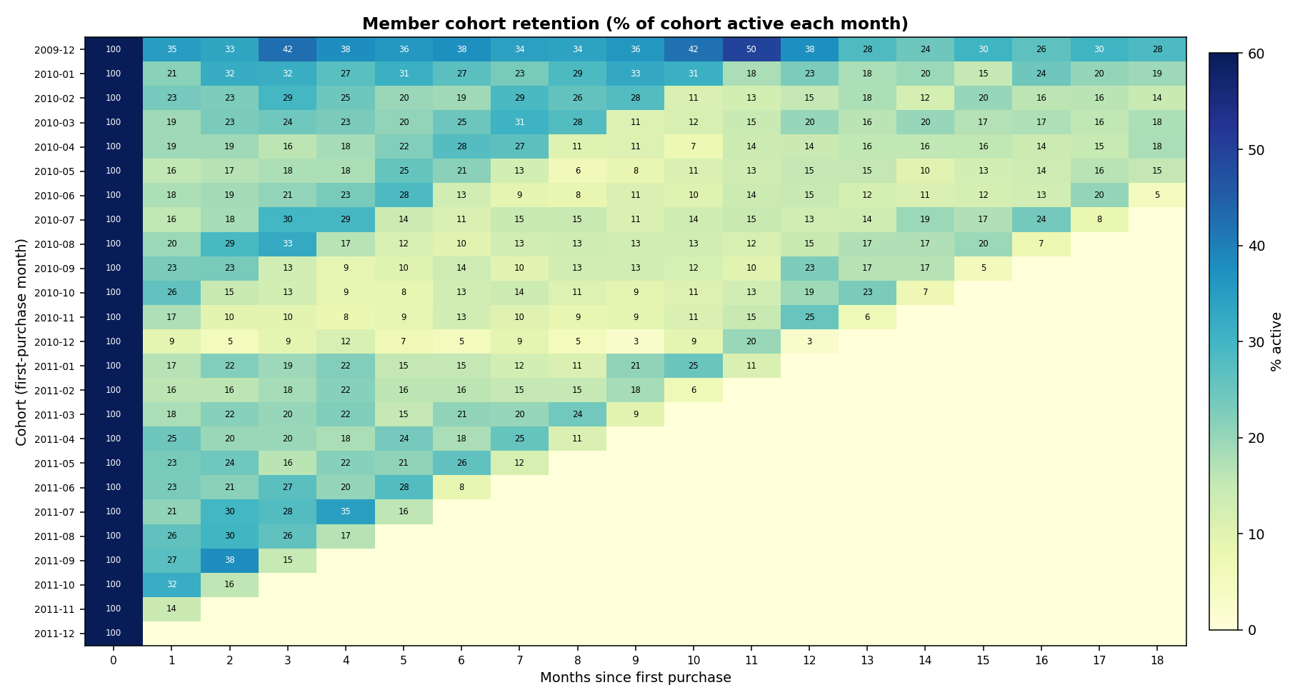
ANALYSIS 2 · COHORTS
Cohort retention — the first-repeat cliff
~20% return in month 1, settling to ~14% by month 6.
The leak is the SECOND purchase → fix with onboarding, not loyalty tiers.
Cohort curves become the retention KPI to test every initiative.
Decay rate feeds CLV and the value model.

Slide 7
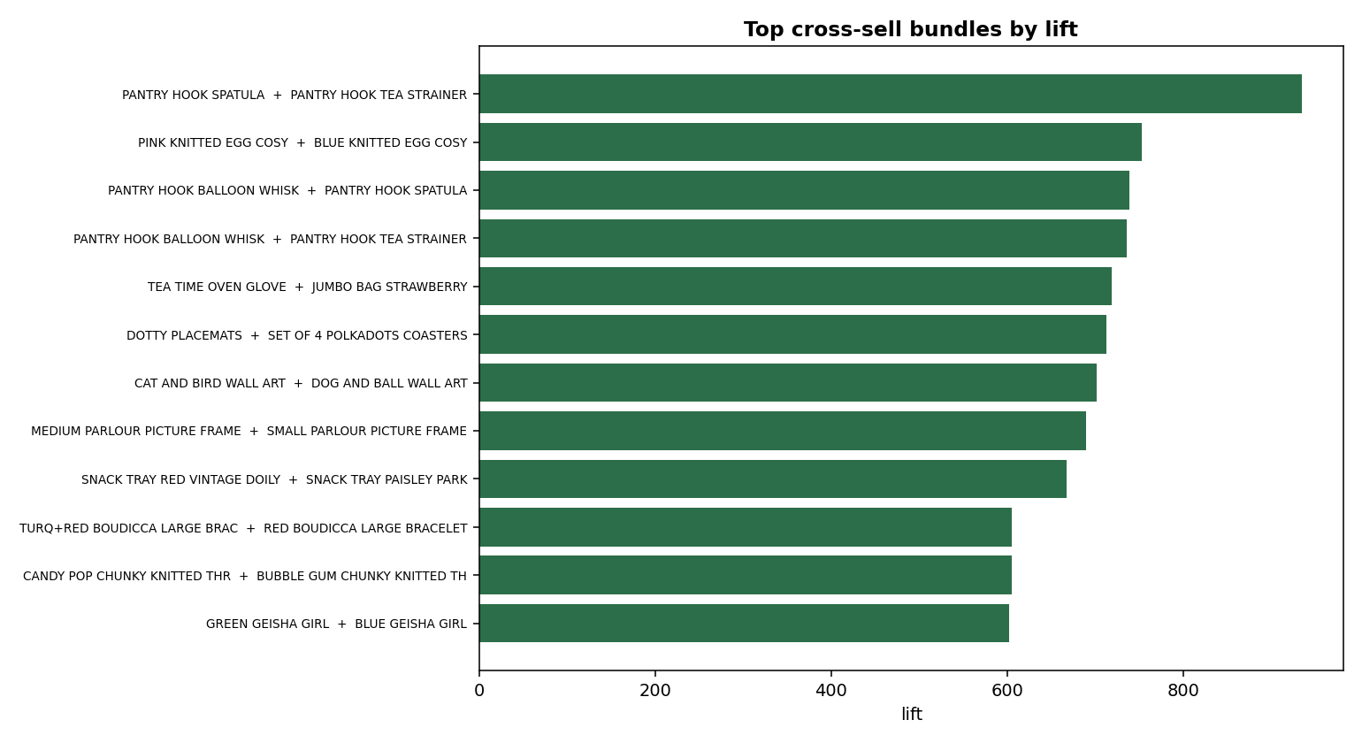
ANALYSIS 3 · CROSS-SELL
Recommender — hit-rate@10 ≈ 100× chance
Item-based collaborative filtering (cosine on the basket×item matrix).
Leave-one-out hit-rate@10 = 24.6% vs 0.24% random.
Affinity rules feed bundle ideas (with merchandiser curation).
Dead-stock paired with high-affinity anchors to clear inventory.
Top cross-sell bundles by lift.

Slide 8
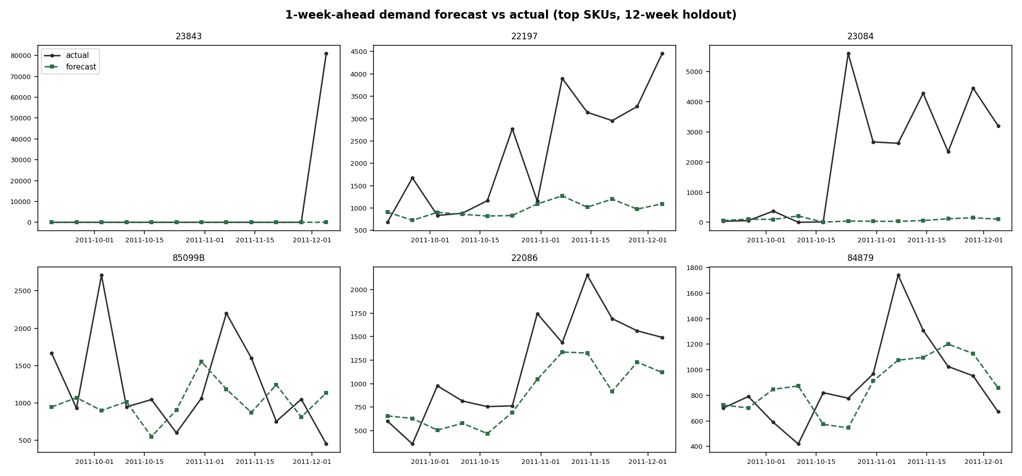
ANALYSIS 4 · FORECAST
Demand forecast + newsvendor stocking
Global XGBoost (log target) vs a 4-week moving-average baseline.
Honest finding: baseline wins aggregate WAPE; XGB wins 61% of SKUs → HYBRID.
Metrics in real units: MAE ≈ 220 units; bias corrected by safety stock.
Newsvendor: order = forecast + 0.48σ → stock for availability & margin.
1-week-ahead forecast vs actual, top SKUs (12-week holdout).

Slide 9
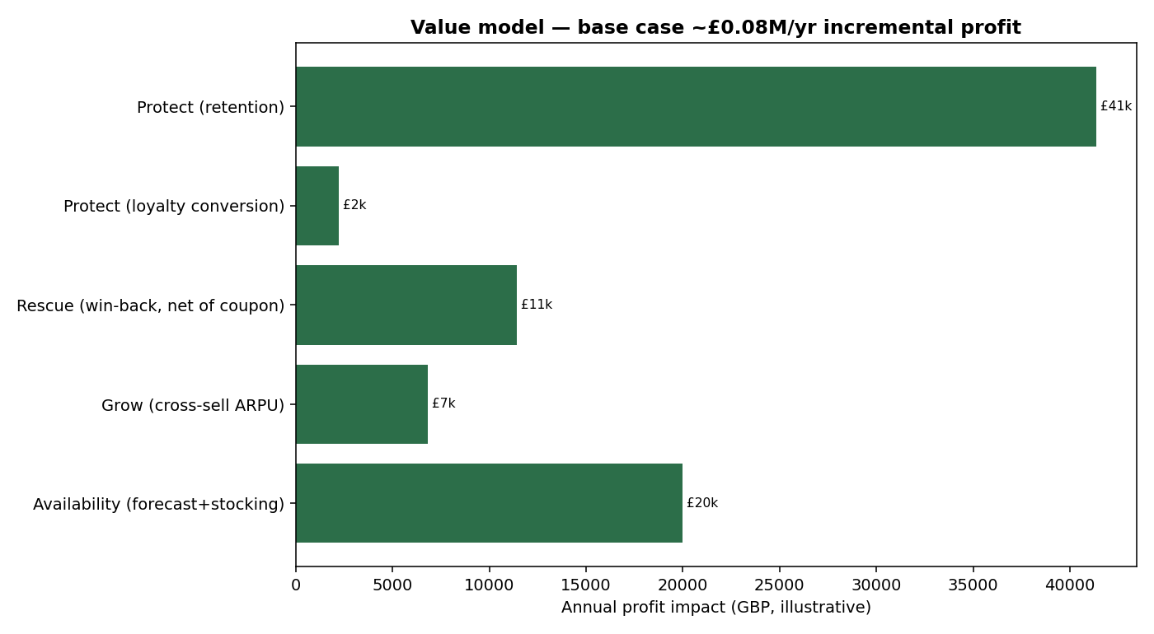
THE VALUE
Levers priced in money — retention is biggest
Revenue bases from real artifacts; uplift assumptions explicit & sensitivity-tested.
Base case ≈ £82k/yr incremental profit (range £41k–£123k).
Ranking: Protect > Availability > Rescue > Grow.
Every play ships with a holdout control to prove incremental lift.

Slide 10
ENGINEERING & HONESTY
How it's built — and what it can't claim
Stack
Python · pandas · scikit-learn · XGBoost · lifetimes (BG/NBD)
scipy · matplotlib · parquet star schema · reproducible modules
LLM-assisted category enrichment (GenAI) · leakage-safe splits
Evaluation
AUC for ranking · WAPE + MAE/RMSE (real units) for forecasts
Always benchmarked vs a simple baseline · holdout controls
Honest caveats (stated, not hidden)
Public UK proxy — methods transfer, product mix does not.
No COGS → margin is an explicit, sensitivity-tested assumption.
Lost sales unobservable → availability lever is assumption-heavy.
Small cohorts (rescue n=250) → directional, expand to gain power.
Simple beat ML on forecast aggregate → hybrid, not a trophy model.

Slide 11
From data to decisions
Clean foundation → warehouse → segmentation, churn, cross-sell, forecasting → £-value.
Business-first framing, leakage-safe modelling, honest metrics and baselines.
Code, methodology, and limitations: README.md and docs/.
Senior Data Scientist portfolio · retail-intelligence

